Slide 1
Unit 7 Normalization
(表格正規化)

Slide 2
PART II: 資料庫設計 (Database Design)
資料庫問題分析與架構規劃:
若有一大量資料想利用DBMS建資料庫來管理。第一步要分析問題，找到使用者需求
實體-關係模型(Entity-Relationship Model,簡稱E-R Model)是一套資料庫的設計工具。我們可以利用E-R Model分析資料庫問題。它可以把真實世界中複雜的問題中的事物和關係轉化為資料庫中的資料架構
由於利用實體-關係模型設計資料庫時, 並不會牽涉到資料庫的操作、儲存方式等複雜的電腦運作。所以,我們會把心力放在需求分析去規劃想要的資料庫，並以實體-關係圖(E-R Diagram)來呈現
資料庫的表格正規化:
實體-關係圖很容易轉化為表格(Tables)，而資料庫就是由許多表格(tables)組成的
這些表格要正規化(Normalization)才能避免將來操作時的異常現象發生
設計介面增刪查改資料庫:
如何方便、又有效率的管理存取資料庫是使用者最關心的二個要素
良好的介面設計，可以讓使用者方便的查詢、方便的新增、方便的刪除、方便的修改的處理資料庫

Slide 3
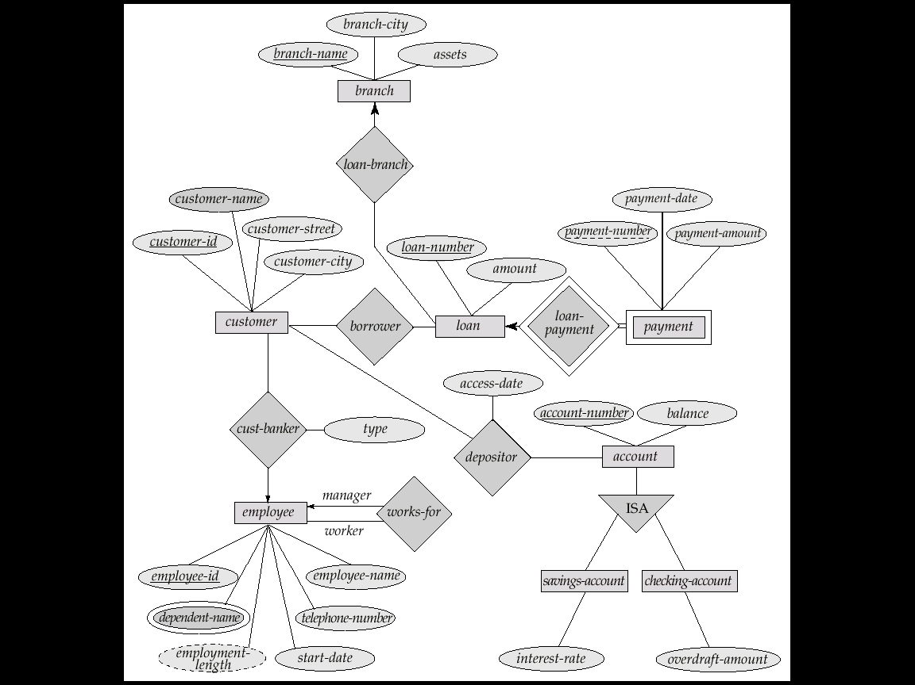
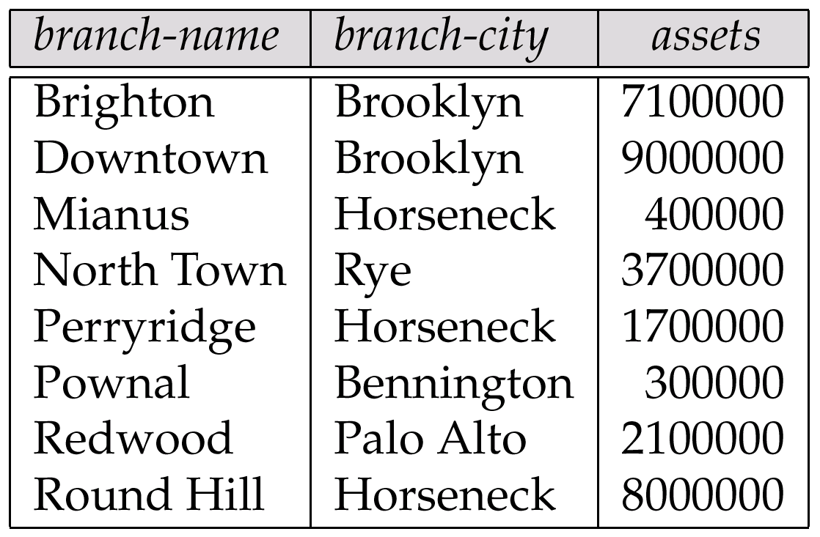
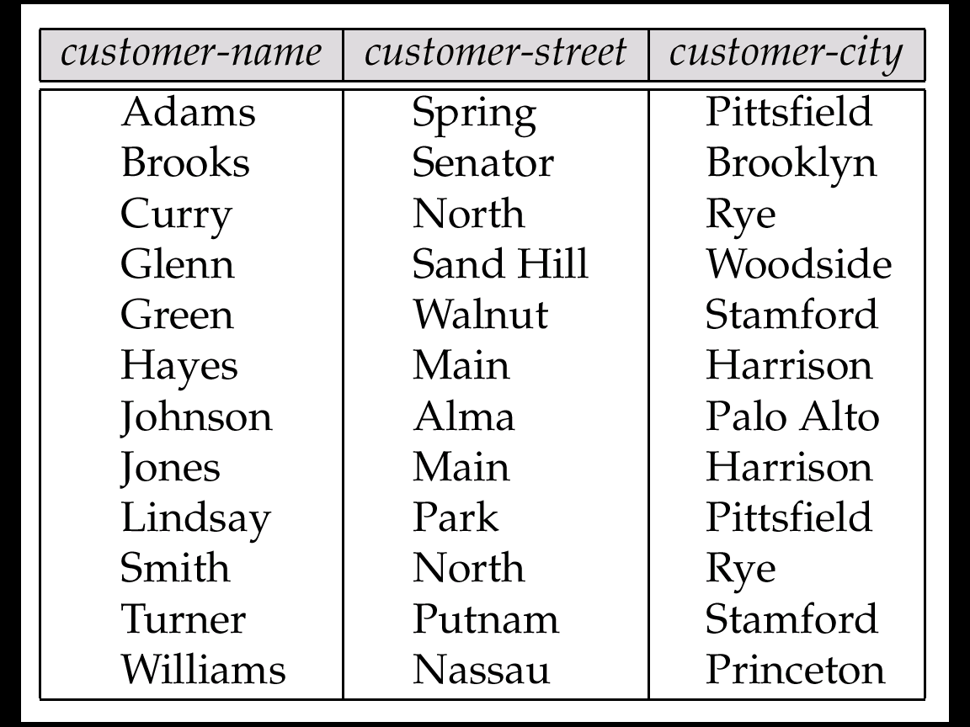
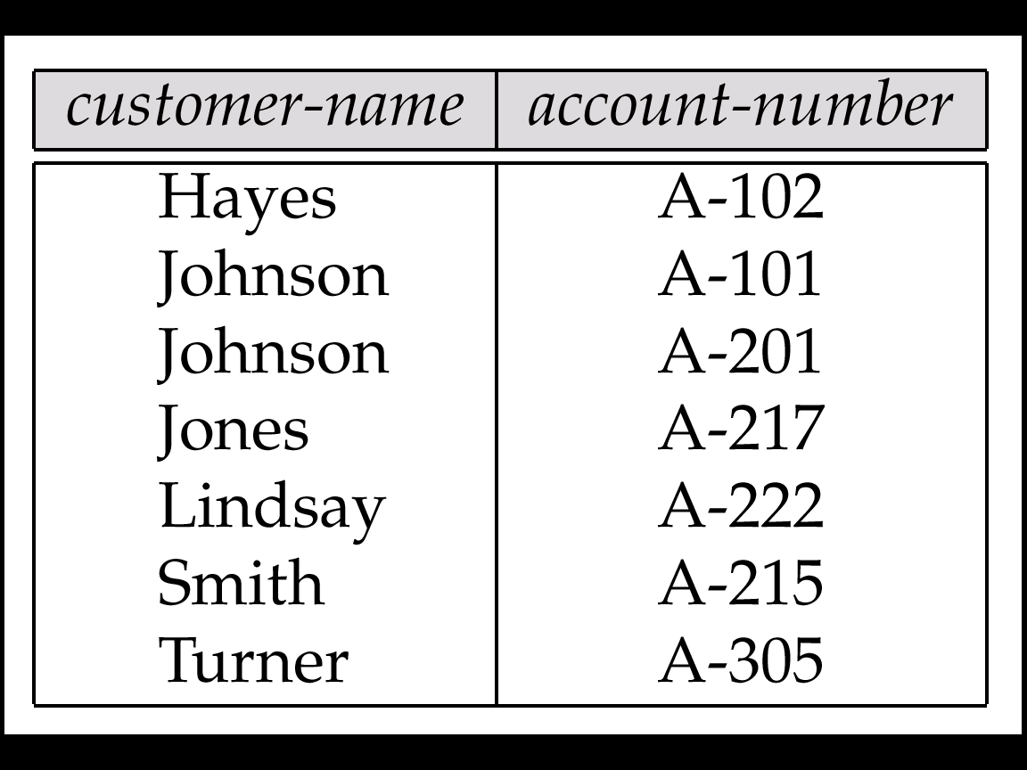
Real-world vs. E-R Model vs. Tables
The real-world enterprise
Semantic Data Model:
Entity-Relationship (E-R) Data Model
1. branch
分公司
2. customer
客戶(存款戶,貸款戶)
3. depositor
存款戶

Slide 4
Contents
7.1 Introduction
7.2 Functional Dependency
7.3 First Normal Form (1NF)
7.4 Second Normal Form (2NF)
7.5 Third Normal Form (3NF)
7.6 Good and Bad Decomposition

Slide 5
7.1 Introduction
Logical Database Design vs. Physical Database Design
Problem of Normalization
Normal Forms

Slide 6
Logical Database Design
Logical Database Design
Semantic Modeling, eg. E-R model (UNIT 6)
Normalization
Problem of Normalization
Given some body of data to be represented in a database, how to decide the suitable logical structure they should have?
what relations should exist?
what attributes should they have?

Slide 7
Problem of Normalization
<e.g.>
S1, Smith, 20, London, P1, Nut, Red, 12, London, 300
S1, Smith, 20, London, P2, Bolt, Green, 17, Paris, 200
.
.
S4, Clark, 20, London, P5, Cam, Blue, 12, Paris, 400
Normalization
S
P
SP
S# SNAME STATUS CITY
S1 Smith 20 London
. . . .
P# ... ... ...
. . . .
. . . .
S# P# QTY
S1 P1 300
S1 P2 200
S'
P
SP'
or
S# SNAME STATUS
S1 Smith 20
S2 . .
. . .
P# ... ... ...
. . . .
. . . .
S# CITY P# QTY
S1 London P1 300
S1 London P2 200
. . . .
Redundancy Update Anomalies!
(異常)

Slide 8
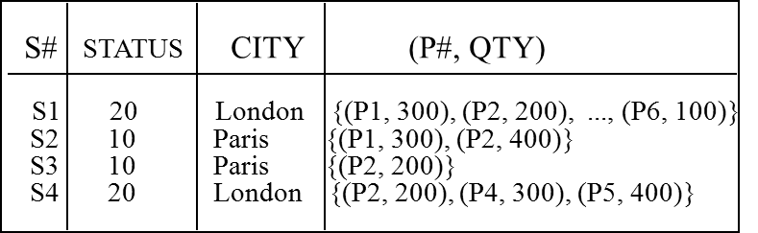
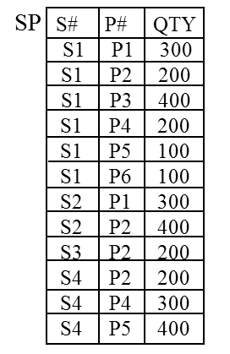
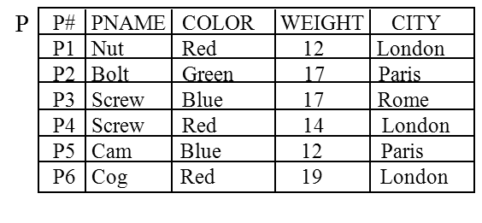
Supplier-and-Parts Database
S1, Smith, 20, London, P1, Nut, Red, 12, London, 300
S1, Smith, 20, London, P2, Bolt, Green, 17, Paris, 200
.
.
S4, Clark, 20, London, P5, Cam, Blue, 12, Paris, 400
Normalization
SSP
?
S
S# SNAME STATUS CITY
S1 Smith 20 London
S2 Jones 10 Paris
S3 Blake 30 Paris
S4 Clark 20 London

Slide 9
Normal Forms
A relation is said to be in a particular normal form if it satisfies a certain set of constraints.
<e.g.> 1NF: A relation is in First Normal Form (1NF) iff it contains only atomic values.
universe of relations (normalized and un-normalized)
1NF relations (normalized relations)
2NF relations
3NF relations
BCNF relations
4NF relations
5NF relations

Slide 10
7.2 Functional Dependency
Functional Dependency (FD)
Fully Functional Dependency (FFD)

Slide 11
Functional Dependency
Functional Dependency
Def: Given a relation R, R.Y is functionally dependent on R.X iff each X-value has associated with it precisely one Y-value (at any time).
Note: X, Y may be the composite attributes.
Notation:
R.X R.Y
read as "R.X functionally determines R.Y"
R
X Y
.
.
.
.
.
S
S# SNAME STATUS CITY
S1 Smith 20 London
S2 Jones 10 Paris
S3 Blake 30 Paris
S4 Clark 20 London
S5 Adams 30 Athens

Slide 12
Functional Dependency (cont.)
<e.g.1>
S
S.S# S.SNAME
S.S# S.STATUS
S.S# S.CITY
S.STATUS S.CITY
FD Diagram:
S
S# SNAME STATUS CITY
S1 Smith 20 London
S2 Jones 10 Paris
S3 Blake 30 Paris
S4 Clark 20 London
S5 Adams 30 Athens
Note: Assume STATUS is some factor of Supplier and no any relationship with CITY.
S#
STATUS
SNAME
CITY
Unit 7 Normalization

Slide 13
Functional Dependency (cont.)
<e.g.2> P
<e.g.3> SP
PNAME
P
P# PNAME COLOR WEIGHT CITY
P1 Nut Red 12 London
P2 Bolt Green 17 Paris
P3 Screw Blue 17 Rome
P4 Screw Red 14 London
P5 Cam Blue 12 Paris
P6 Cog Red 19 London
COLOR
P#
WEIGHT
CITY
SP
S# P# QTY
S1 P1 300
S1 P2 200
S1 P3 400
S1 P4 200
S1 P5 100
S1 P6 100
S2 P1 300
S2 P2 400
S3 P2 200
S4 P2 200
S4 P4 300
S4 P5 400
S#
QTY
P#
If X is a candidate key of R, then all attributes Y of R are functionally dependent on X. (i.e. X Y)

Slide 14
Fully Functional Dependency (FFD)
Def: Y is fully functionally dependent on X iff
(1) Y is FD on X
(2) Y is not FD on any proper subset of X.
<e.g.> SP' (S#, CITY, P#, QTY)
S# |  | city₁ | city₂
S1 |  | London | Taipei
SP'
S# CITY P# QTY
S1 London P1 300
S1 London P2 200
… …. … ...
S#
FFD
QTY
P#
S#
FD
not FFD
FD
S# CITY
… …..
CITY
S#
CITY
P#

Slide 15
Fully Functional Dependency (cont.)
<Note> 1. Normally, we take FD to mean FFD.
2. FD is a semantic notion.
<e.g.> S# CITY
Means: each supplier is located in precisely one city.
3. FD is a special kind of integrity constraint.
CREATE INTEGRITY RULE SCFD
CHECK FORALL SX FORALL SY
(IF SX.S# = SY.S# THEN SX.CITY = SY.CITY);
4. FDs considered here applied within a single relation.
<e.g.> SP.S# S.S# is not considered!
(Ref P.10-9)

Slide 16
7.3 First Normal Form (1NF)

Slide 17
Normal Forms: 1NF
Def: A relation is in 1NF iff all underlying simple domains contain atomic values only.
Fact?
FIRST
S# STATUS CITY P# QTY
S1 20 London P1 300
S1 20 London P2 200
S1 20 London P3 400
S1 20 London P4 200
S1 20 London P5 100
S1 20 London P6 100
S2 10 Paris P1 300
S2 10 Paris P2 400
S3 10 Paris P2 200
S4 20 London P2 200
S4 20 London P4 300
S4 20 London P5 400
S# STATUS CITY (P#, QTY)
S1 20 London {(P1, 300), (P2, 200), ..., (P6, 100)}
S2 10 Paris {(P1, 300), (P2, 400)}
S3 10 Paris {(P2, 200)}
S4 20 London {(P2, 200), (P4, 300), (P5, 400)}
Suppose 1. CITY is the main office of the supplier.
2. STATUS is some factor of CITY
Key:(S#,P#),
Normalized 1NF

Slide 18
1NF Problem: Update Anomalies!
<1> Update
If suppler S1 moves from London to Paris, then 6
tuples must be updated!
<2> Insertion
Cannot insert a supplier information if it doesn't
supply any part, because that will cause a null key
value.
<3> Deletion
Delete the information that "S3 supplies P2", then
the fact "S3 is located in Paris" is also deleted.
FIRST
S# STATUS CITY P# QTY
S1 20 London P1 300
S1 20 London P2 200
S1 20 London P3 400
S1 20 London P4 200
S1 20 London P5 100
S1 20 London P6 100
S2 10 Paris P1 300
S2 10 Paris P2 400
S3 10 Paris P2 200
S4 20 London P2 200
S4 20 London P4 300
S4 20 London P5 400
FIRST
S# STATUS CITY P# QTY
. . . . .
S3 20 Paris P2 300
. . . . .
. . . . .
S5 30 Athens NULL NULL
Key:(S#,P#),
Normalized 1NF

Slide 19
1NF Problem: Update Anomalies! (cont.)
Non-key attributes are NOT FFD on primary key. (e.g. QTY, STATUS, CITY in FIRST)
FIRST
<e.g.> Suppose 1. CITY is the main office of the supplier.
2. STATUS is some factor of CITY (ref.p.7-10)
Primary key of FIRST: (S#, P#)
FD diagram of FIRST:
S# STATUS CITY P# QTY
S1 20 London P1 300
S1 20 London P2 200
S1 20 London P3 400
S1 20 London P4 200
S1 20 London P5 100
S1 20 London P6 100
S2 10 Paris P1 300
S2 10 Paris P2 400
S3 10 Paris P2 200
S4 20 London P2 200
S4 20 London P4 300
S4 20 London P5 400
FFD
x FFD
STATUS
FFD
S#
QTY
x FFD
P#
CITY
FFD
Key:(S#,P#),
Normalized 1NF
FD:
1. S# STATUS
2. S# CITY
3. CITY STATUS
4. (S#, P#) QTY
primary key (S#, P#) STATUS
primary key (S#, P#) CITY
FFD
FFD

Slide 20
7.4 Second Normal Form (2NF)
FIRST
SP (in 2NF)
S# STATUS CITY P# QTY
S1 20 London P1 300
S1 20 London P2 200
S1 20 London P3 400
S1 20 London P4 200
S1 20 London P5 100
S1 20 London P6 100
S2 10 Paris P1 300
S2 10 Paris P2 400
S3 10 Paris P2 200
S4 20 London P2 200
S4 20 London P4 300
S4 20 London P5 400
SECOND (in 2NF)
S# P# QTY
S1 P1 300
S1 P2 200
S1 P3 400
S1 P4 200
S1 P5 100
S1 P6 100
S2 P1 300
S2 P2 400
S3 P2 200
S4 P2 200
S4 P4 300
S4 P5 400
S# STATUS CITY
S1 20 London
S2 10 Paris
S3 10 Paris
S4 20 London
S5 30 Athens

Slide 21
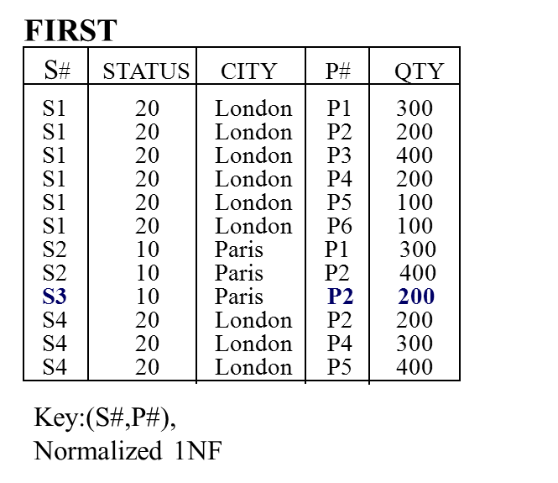
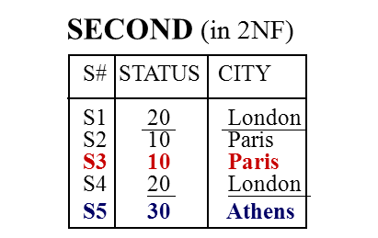
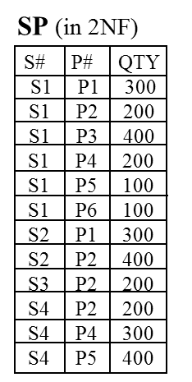
Normal Form: 2NF
Def: A relation R is in 2NF iff
(1) R is in 1NF (i.e. atomic )
(2) Non-key attributes are FFD on primary key. (QTY, STATUS, CITY in FIRST)
<e.g.> FIRST is in 1NF, but not in 2NF
(S#, P#) STATUS, and
(S#, P#) CITY
FFD
x FFD
FFD
STATUS
FFD
S#
FFD
QTY
x FFD
Decompose FIRST into:
P#
CITY
FFD
<1> SECOND (S#, STATUS, CITY): primary key: S#
<2> SP (S#, P#, QTY):
Primary key: (S#, p#)
FD:
1. S# STATUS
2. S# CITY
3. CITY STATUS
STATUS
S#
QTY
S#
P#
CITY
FD: 4. (S#, P#) QTY

Slide 22
Normal Form: 2NF (cont.)
FIRST
S# STATUS CITY P# QTY
S1 20 London P1 300
S1 20 London P2 200
S1 20 London P3 400
S1 20 London P4 200
S1 20 London P5 100
S1 20 London P6 100
S2 10 Paris P1 300
S2 10 Paris P2 400
S3 10 Paris P2 200
S4 20 London P2 200
S4 20 London P4 300
S4 20 London P5 400
SECOND (in 2NF)
S# STATUS CITY
S1 20 London
S2 10 Paris
S3 10 Paris
S4 20 London
S5 30 Athens
SP (in 2NF)
S# P# QTY
S1 P1 300
S1 P2 200
S1 P3 400
S1 P4 200
S1 P5 100
S1 P6 100
S2 P1 300
S2 P2 400
S3 P2 200
S4 P2 200
S4 P4 300
S4 P5 400
<1> Update: S1 moves from London to Paris
<2> Insertion: (S5 30 Athens)
<3> Deletion
Delete "S3 supplies P2 200", then the fact "S3 is located in Paris" is also deleted.

Slide 23
Normal Form: 2NF (cont.)
A relation in 1NF can always be reduced to an equivalent collection of 2NF relations.
The reduction process from 1NF to 2NF is non-loss decomposition.
FIRST(S#, STATUS, SCITY, P#, QTY)
projections natural joins
SECOND(S#, STATUS, CITY), SP(S#,P#,QTY)
The collection of 2NF relations may contain “more” information than the equivalent 1NF relation.
<e.g.> (S5, 30, Athens)
1st
2nd
SP

Slide 24
Problem: Update Anomalies in SECOND!
Update Anomalies in SECOND
<1> UPDATE: if the status of London is changed from 20
to 60, then two tuples must be updated
<2> DELETE: delete supplier S5, then the fact "the
status of Athens is 30" is also deleted!
<3>INSERT: cannot insert the fact "the status of Rome
is 50"!
Why:
S.S# S.STATUS
S.S# S. CITY
S.CITY S.STATUS cause a transitive dependency
SECOND (in 2NF)
S# STATUS CITY
S1 20 London
S2 10 Paris
S3 10 Paris
S4 20 London
S5 30 Athens
FD:
1. S# STATUS
2. S# CITY
3. CITY STATUS
STATUS
S#
CITY

Slide 25
7.5 Third Normal Form (3NF)
SECOND
SC (in 3NF)
CS (in 3NF)
S# STATUS CITY
S1 20 London
S2 10 Paris
S3 10 Paris
S4 20 London
S5 30 Athens
S# CITY
S1 London
S2 Paris
S3 Paris
S4 London
S5 Athens
CITY STATUS
Athens 30
London 20
Paris 10
Rome 50

Slide 26
Normal Forms: 3NF
Def : A relation R is in 3NF iff
(1) R is in 2NF
(2) Every non-key attribute is non-transitively dependent on the primary key.
e.g. STATUS is transitively on S#
(i.e., non-key attributes are mutually independent)
<e.g.> SP is in 3NF, but SECOND is not!
SECOND (not 3NF)
SP FD diagram
SECOND FD diagram
S# STATUS CITY
S1 20 London
S2 10 Paris
S3 10 Paris
S4 20 London
S5 30 Athens
STATUS
S#
S#
QTY
P#
CITY

Slide 27
Normal Forms: 3NF (cont.)
Decompose SECOND into:
SECOND
<1> SC(S#, CITY)
primary key : S#
FD diagram:
<2> CS(CITY, STATUS):
primary key: CITY
FD diagram:
S# STATUS CITY
S1 20 London
S2 10 Paris
S3 10 Paris
S4 20 London
S5 30 Athens
S#
CITY
STATUS
CITY
STATUS
S#
CITY
SC (in 3NF)
CS (in 3NF)
S# CITY
S1 London
S2 Paris
S3 Paris
S4 London
S5 Athens
CITY STATUS
Athens 30
London 20
Paris 10
Rome 50

Slide 28
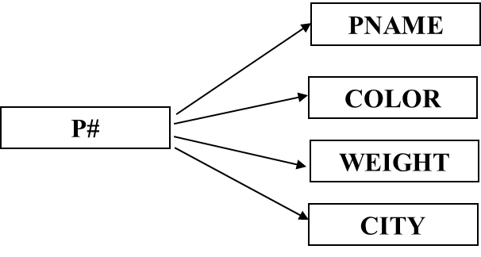
Normal Forms: 3NF (cont.)
Consider P:
Def: A relation is in 1NF iff all underlying simple domains contain atomic values only.
Def: A relation R is in 2NF iff
(1) R is in 1NF (i.e. atomic )
(2) Non-key attributes are FFD on primary key.
Def : A relation R is in 3NF iff
(1) R is in 2NF
(2) Every non-key attribute is non-transitively dependent on the primary key.
(i.e., non-key attributes are mutually independent)
P
P# PNAME COLOR WEIGHT CITY
P1 Nut Red 12 London
P2 Bolt Green 17 Paris
P3 Screw Blue 17 Rome
P4 Screw Red 14 London
P5 Cam Blue 12 Paris
P6 Cog Red 19 London

Slide 29
Normal Forms: 3NF (cont.)
Note:
(1) Any 2NF diagram can always be reduced to a collection of 3NF relations.
(2) The reduction process from 2NF to 3NF is non-loss decomposition.
(3) The collection of 3NF relations may contain "more information" than the equivalent 2NF relation.

Slide 30
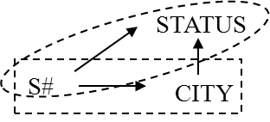
7.6 Good and Bad Decomposition
SECOND
S# STATUS CITY
S1 20 London
S2 10 Paris
S3 10 Paris
S4 20 London
S5 30 Athens
STATUS
S#
CITY
SC (in 3NF)
CS (in 3NF)
SC (in 3NF)
SS (in 3NF)
S# CITY
S1 London
S2 Paris
S3 Paris
S4 London
S5 Athens
CITY STATUS
Athens 30
London 20
Paris 10
Rome 50
S# CITY
S1 London
S2 Paris
S3 Paris
S4 London
S5 Athens
S# STATUS
S1 20
S2 10
S3 10
S4 20
S5 30

Slide 31
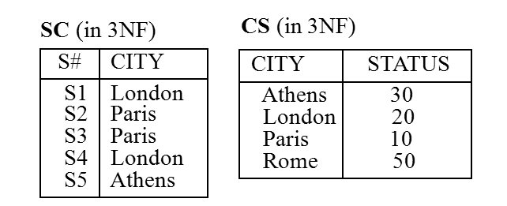
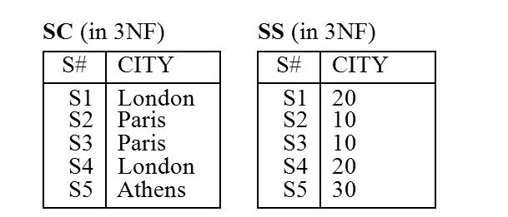
Good and Bad Decomposition
Consider
transitive FD
STATUS
Suppose 1. CITY is the main office of the supplier.
2. STATUS is some factor of CITY (ref. p.7-9)
S#
CITY
STATUS
STATUS
S#
CITY
S#
CITY
①Decomposition A:
② Decomposition B:
SC:
SC:
S#
CITY
S#
CITY
CS:
SS:
CITY
STATUS
S#
STATUS
Good !
(Rome, 50) can be inserted.
Bad !
(Rome, 50) can not be inserted unless there is a supplier located at Rome.

Slide 32
Good and Bad Decomposition (cont.)
Independent Projection: (by Rissanen '77, ref[10.6])
Def: Projections R1 and R2 of R are independent iff
(1) Any FD in R can be reduced from those in R1 and R2.
(2) The common attribute of R1 and R2 forms a candidate key for at least one of R1 and R2.
<e.g.>
Decomposition A:
SECOND(S#, STATUS, CITY)
(R)
(1) FD in SECOND (R):
S# CITY
CITY STATUS
S# STATUS
FD in SC and CS
R1: S# CITY
R2: CITY STATUS
(2) Common attribute of SC and CS is CITY, which is the primary key of CS.
∴ SC and CS are independent → Decomposition A is good!
Projection
R1
R2
R
{
(R1)
SC (S#, CITY)
CS (CITY, STATUS)
(R2)
S# STATUS

Slide 33
Good and Bad Decomposition (cont.)
Decomposition B:
SECOND(S#, STATUS, CITY)
(1) FD in SC and SS:
S# CITY
S# STATUS
∴ SC and SS are dependent → decomposition B is bad!
though common attr. S# is primary key of both SC, SS.
{
SC (S#, CITY)
SS (S#, STATUS)
CITY STATUS

Slide 34
Normal Forms
universe of relations (normalized and un-normalized)
1NF relations (normalized relations)
2NF relations
3NF relations
BCNF relations
4NF relations
5NF relations

Slide 35
Unit 18 More on Normalization
18.1 Introduction
18.2 Functional Dependency
18.3 First, Second, and Third Normal Forms (1NF, 2NF, 3NF)
18.4 Boyce/Codd Normal Form (BCNF)
18.5 Fourth Normal Form (4NF)
18.6 Fifth Normal Form (5NF)

Slide 36
EX.part2.2: Tables and SQL
Reduction E-R Model to Relational Tables
Refer to UNIT 6, Sec. 7
Transfer your E-R model to Tables
Check each Table to see if it is a
1NF,
2NF,
3NF
Design Query
Using SQL to define and create Tables
Design some queries to access your database
Using SQL to query your database
…

Slide 37
end of unit 7

